Slide 1


Slide 2
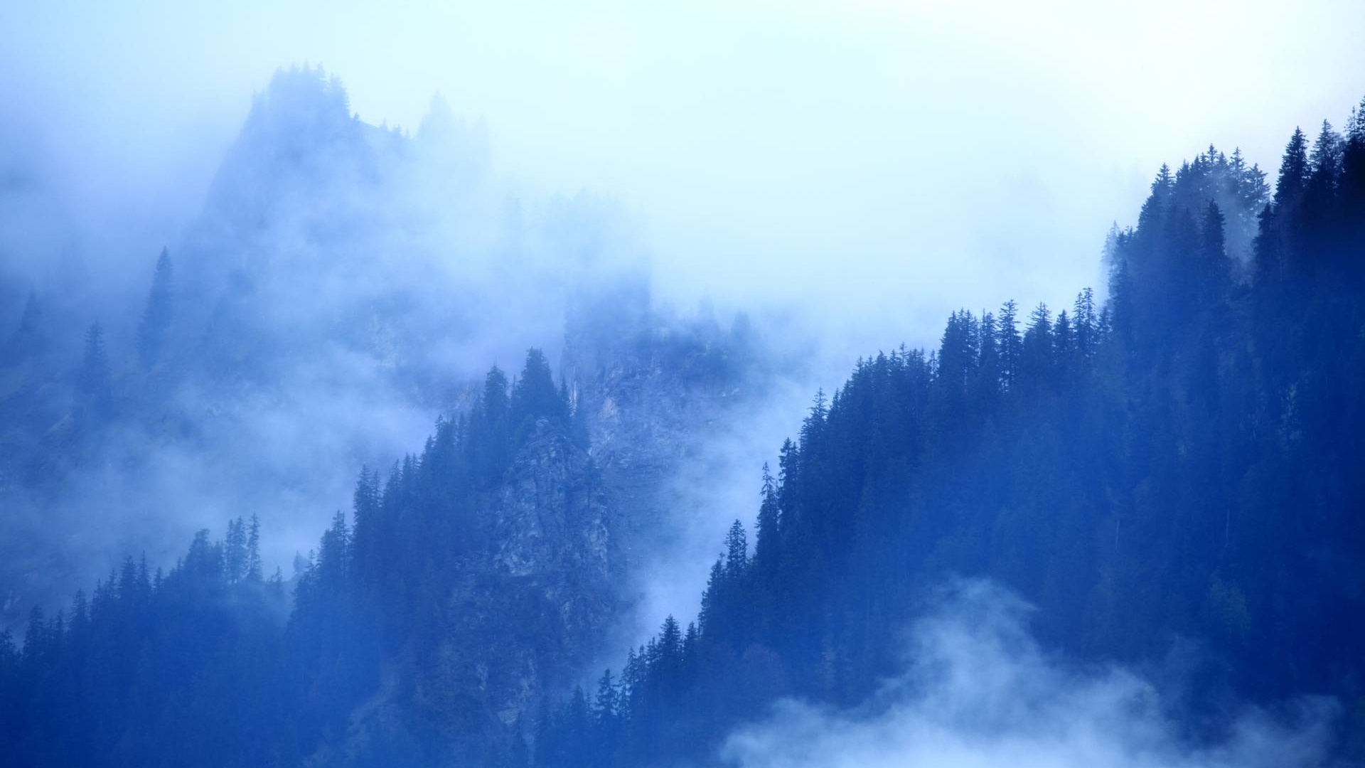
Our God Is Alive!

Slide 3
See God’s Hand In Creation
How often do you look at admire creation and forget who created it?
First step is seeing the Creation as the Work of God
Second is realizing its continued existence depends on God
God still controls this world

Slide 4
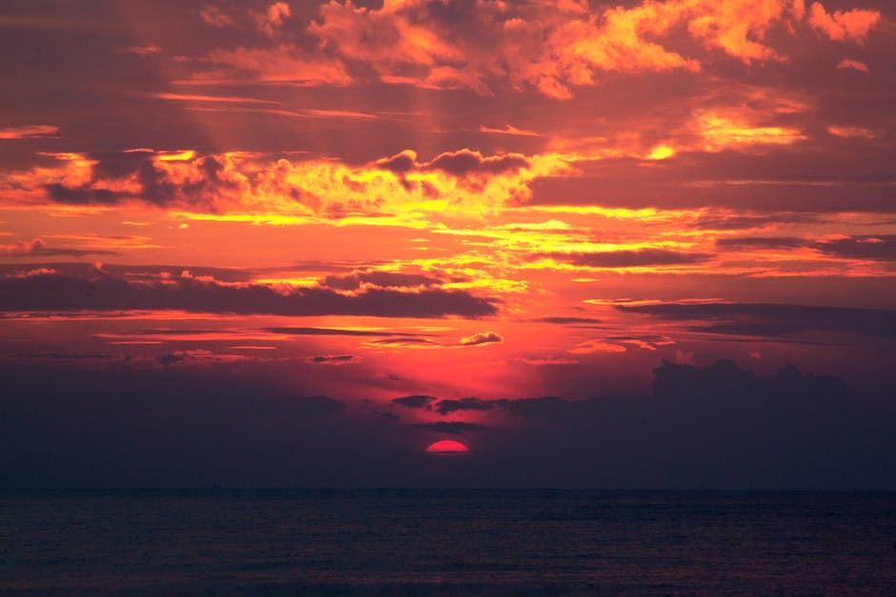
THE SUN
Matthew 5:45
The Sun Belongs To God

Slide 5

THE SEASONS
Genesis 8:22 “While the earth remains, seedtime and harvest, and cold and heat, and winter and summer, and day and night shall not cease.”
Acts 14:17 “He did not leave Himself without witness,”
Summer is here – because of God’s Promise and His Existence.
How much of our daily happiness is due to GOD?

Slide 6
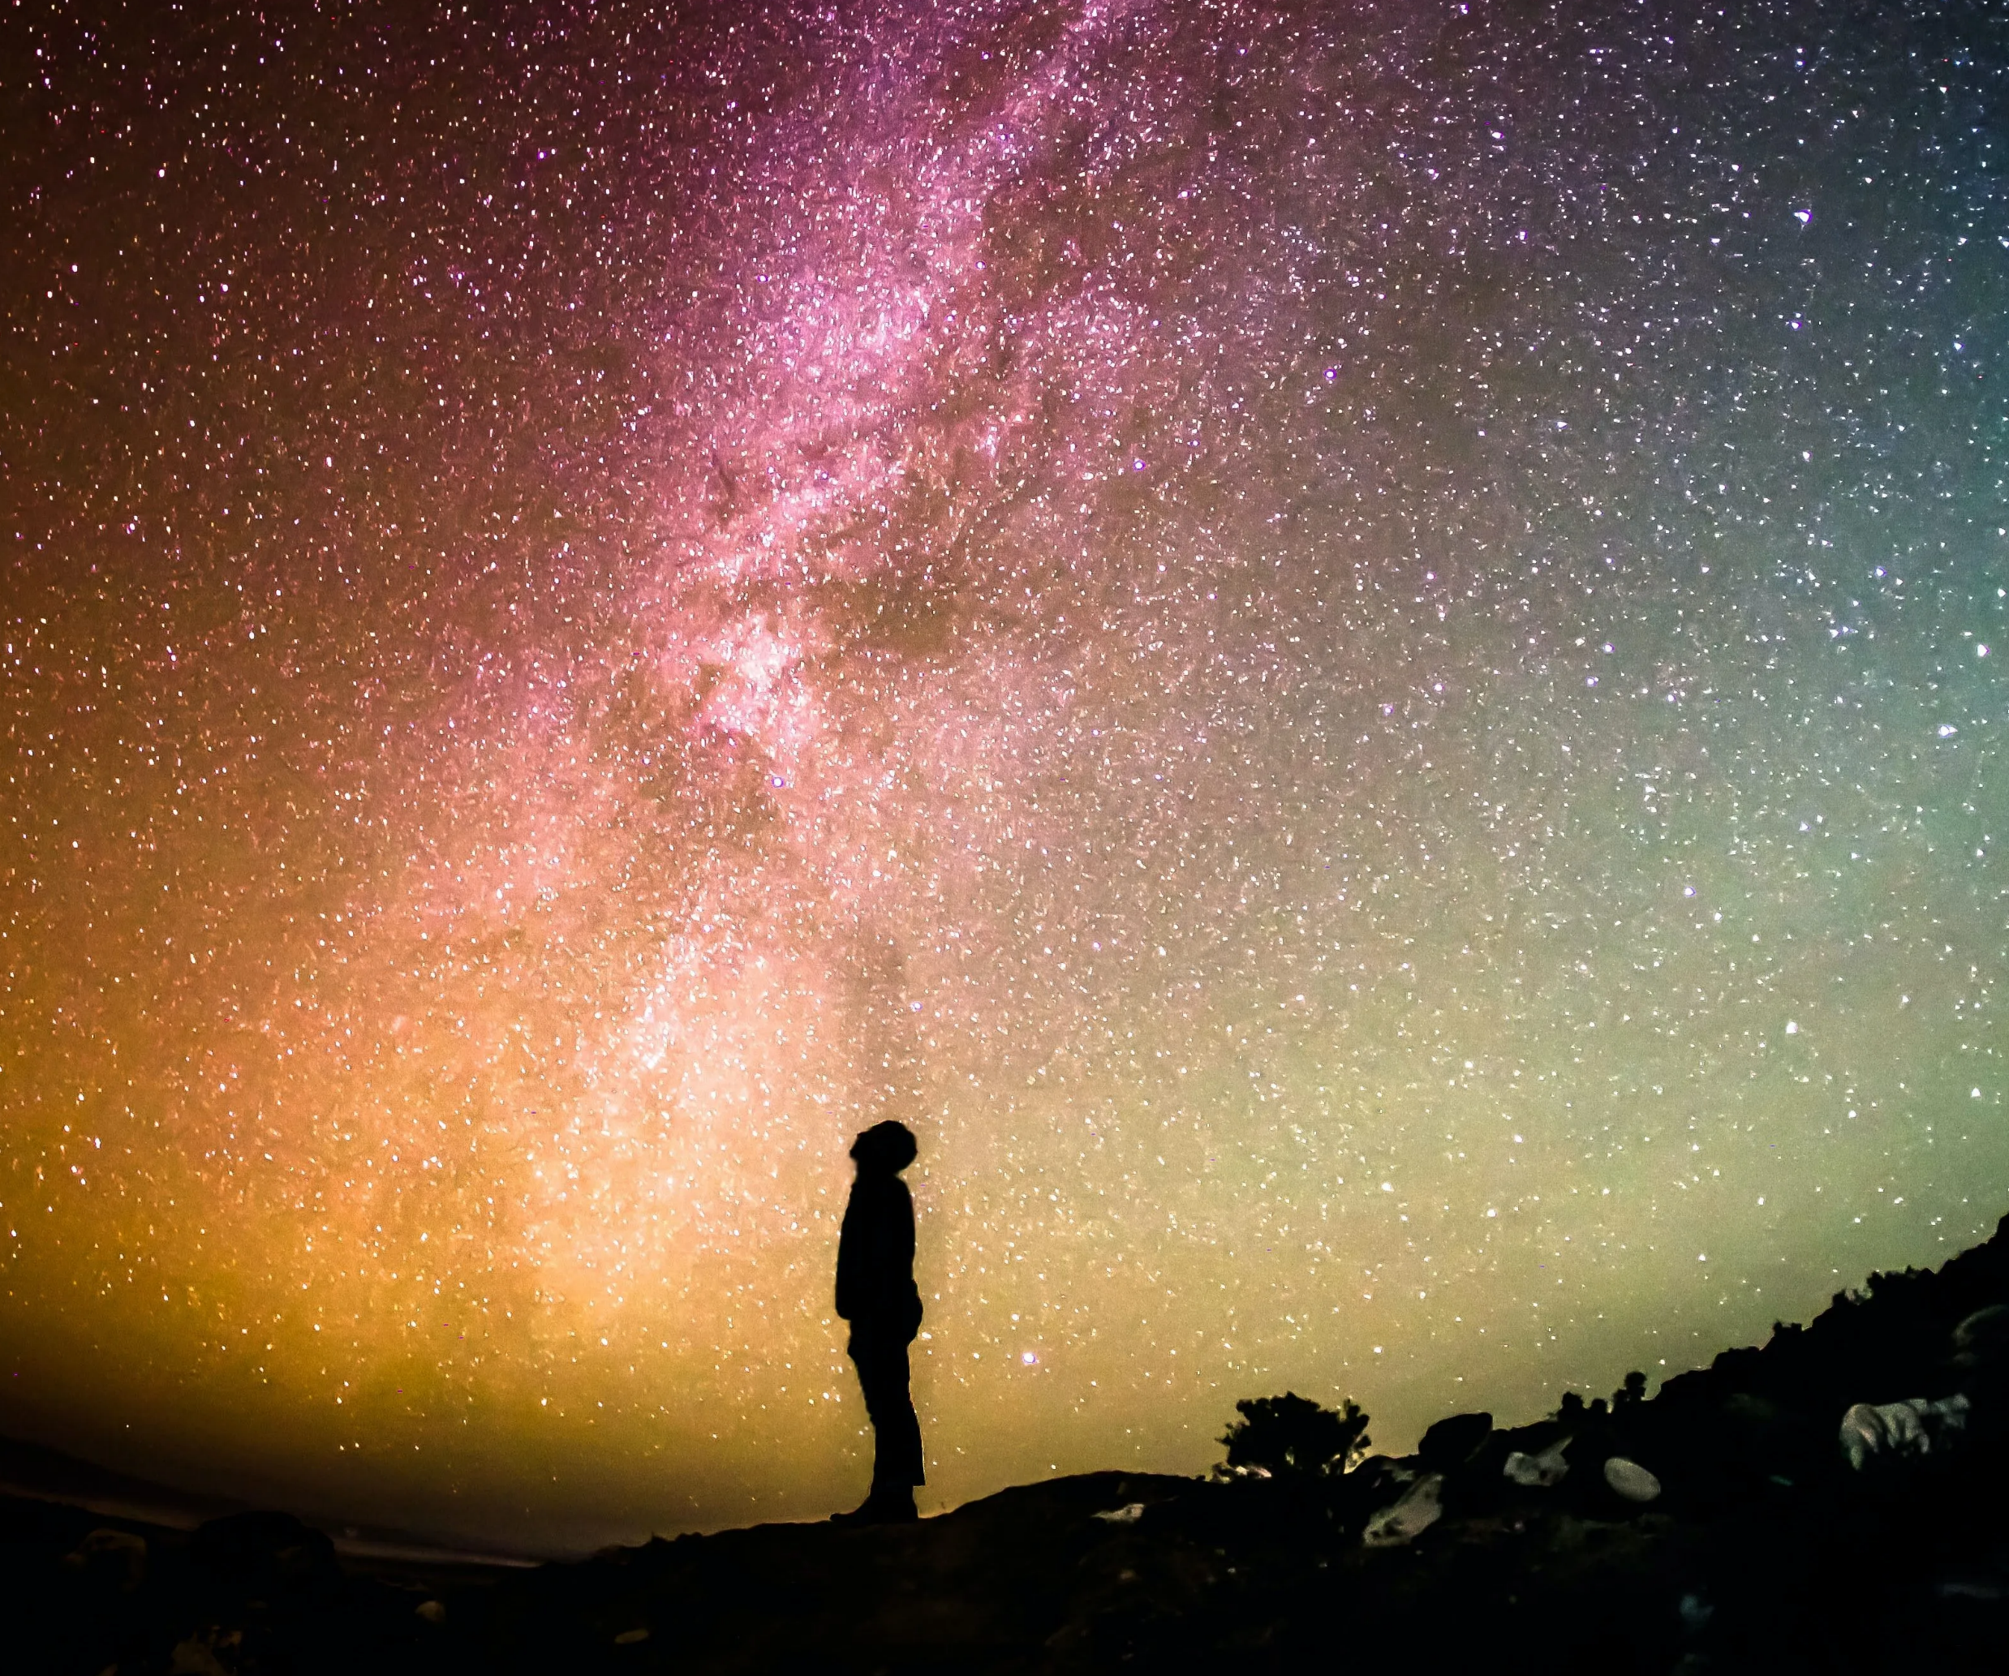
THE UNIVERSE
Colossians 1:16,17
“by Him all things stand together” Vine
“hold together” Arndt
“Significant theologically is the statement in Col. 1:17 that Christ is before all things and all things consist or have their existence in Him.”
God continues to hold the Universe together

Slide 7

Psalm 47:8
Jeremiah 27:5,6
Daniel 2:21
Daniel 4:17
Romans 13:1-7
Just as easy as God created the Earth – He can give dominion to whom He will!
AND He can take it away!

Slide 8
GOD CAN USE US
Daniel 4:17 “the Most High rules in the kingdom of men, gives it to whomever He will, and sets over it the lowest of men."
God can use ANYONE!
Deuteronomy 8:18 “the Lord your God, for {it is} He who gives you power to get wealth”
1 Chronicles 29:12 “You reign over all”
Revelation 3:8 “I have set before you an open door, and no one can shut it”
We must realize that GOD can do great things through us also – and it does not depend on our own strength!

Slide 9
WHO KNOWS WHAT GOD IS DOING?
1 Samuel 14:6 “nothing restrains the Lord from saving by many or by few."
2 Samuel 12:22 “`Who can tell {whether} the Lord will be gracious to me, that the child may live?’”
Daniel 3:16-18 “"If that {is the case}, our God whom we serve is able to deliver us from the burning fiery furnace, and He will deliver {us} from your hand, O king.”
Acts 18:9,10 “Do not be afraid, but speak, and do not keep silent; for I am with you, and no one will attack you to hurt you; for I have many people in this city."
Acts 18:14,15

Slide 10
HOW DO YOU LOOK AT LIFE?
Do you look at things that happen as INCONVENIENCES or OPPORTUNITIES?
Colossians 4:5 "Walk in wisdom toward those {who are} outside, redeeming the time."
“Why has this person crossed my path? Could it be my opportunity to save them?”
GOD CAN USE GOOD & BAD
Genesis 50:20 “you meant evil against me; {but} God meant it for good”
Philippians 1:12 “the things {which happened} to me have actually turned out for the furtherance of the gospel."

Slide 11
FRAGILE NATURE OF OUR LIVES
Acts 17:25 “..He gives to all life, breath, and all things."
Acts 17:28 “for in Him we live and move and have our being,..."
James 4:15 “"If the Lord wills, we shall live and do this or that." 1 Corinthians 4:19; 16:7
PILGRIM MENTALITY
Hebrews 11:13 “…confessed that they were strangers and pilgrims on the earth.”
2 Corinthians 4:16-18 “we do not look at the things which are seen, but at the things which are not seen. For the things which are seen {are} temporary, but the things which are not seen {are} eternal."

Slide 12
PEOPLE OF THE BOOK
1 Thessalonians 5:21 NKJV 21 Test all things; hold fast what is good.”
Using His word as our Daily Guide in life
ALL SOULS BELONG TO HIM!
Ezekiel 18:4 “Behold, all souls are Mine; the soul of the father as well as the soul of the son is Mine; the soul who sins shall die."
ALL SOULS WILL ANSWER TO GOD IN JUDGMENT! Romans 14:11,12 "As I live, says the Lord, every knee shall bow to Me, and every tongue shall confess to God." (12) So then each of us shall give account of himself to God."
“Am I READY TO ANSWER TO GOD FOR THIS?

Slide 13
Our God Is Alive!
ALL PEOPLE
ALL MEMBERS
WE ARE ALL RESPONSIBLE TO GOD!

